Slide 1
Sprint 1
CB06 - group 4
Emanuil Karapachov
Vlad Cojocariu
Stanimir Nikolov
Wondimu Woldeaarggiye

Slide 2
Agenda
Updated Sitemap
Wireframes Review
First look of the app
Questions/Planning for the next sprint

Slide 3
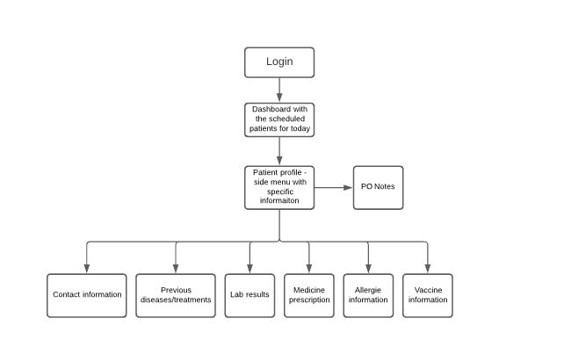
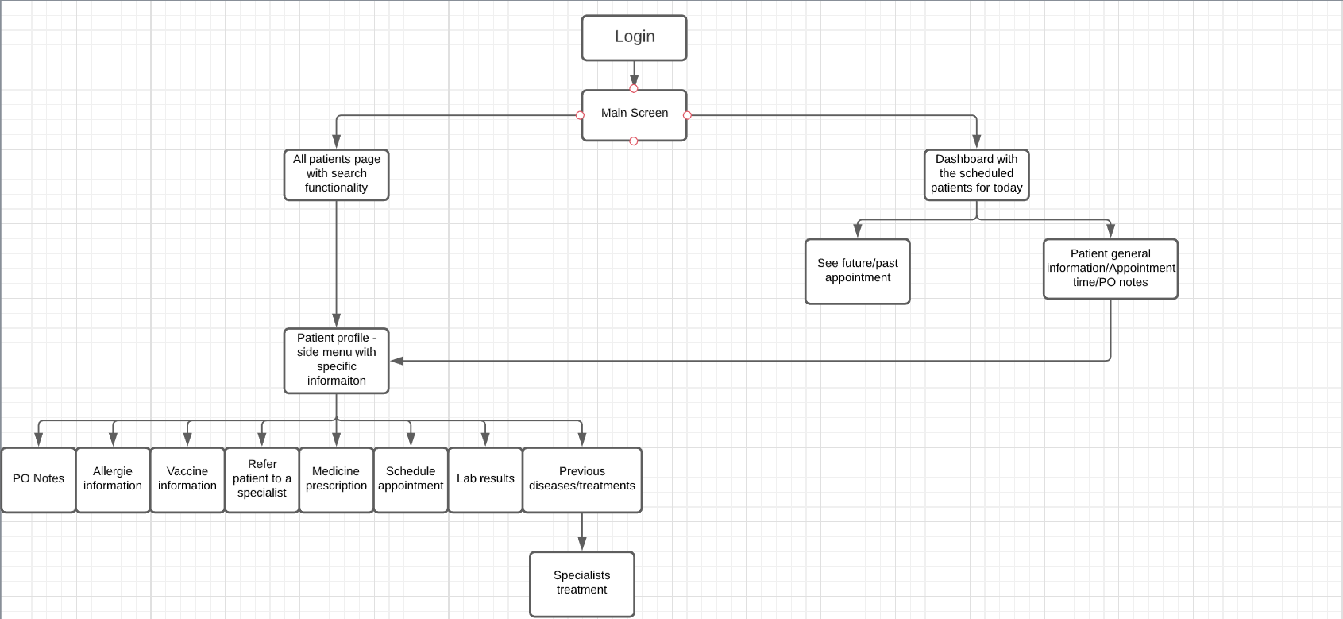
Sitemap:
Old VS New

Slide 4
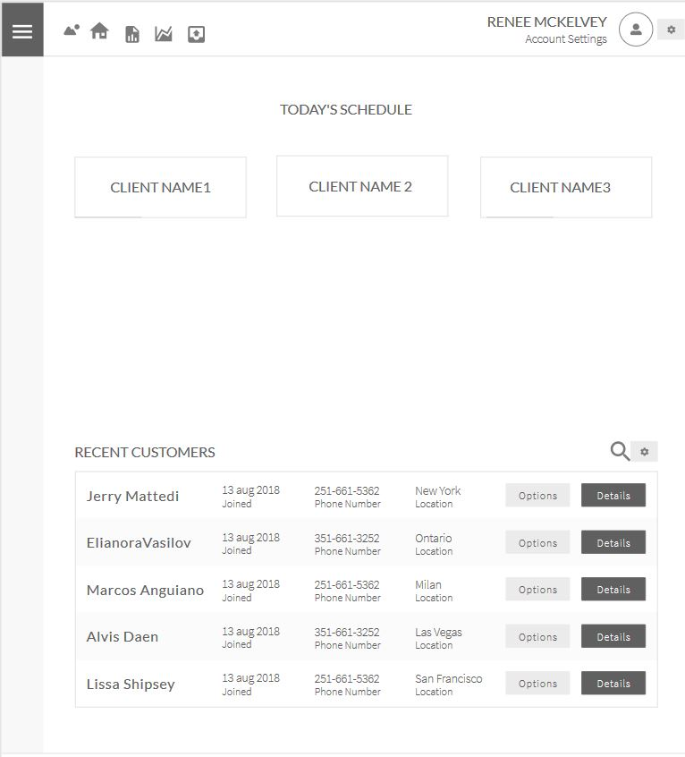
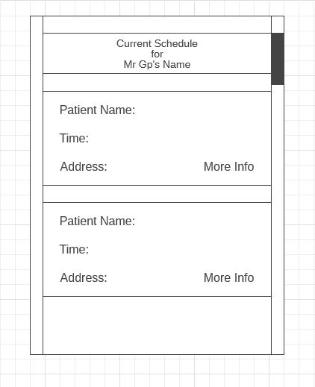
Updated Concepts
VS

Slide 5
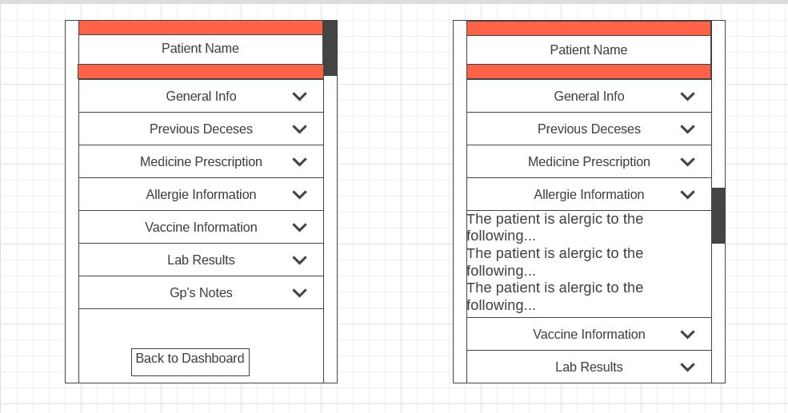
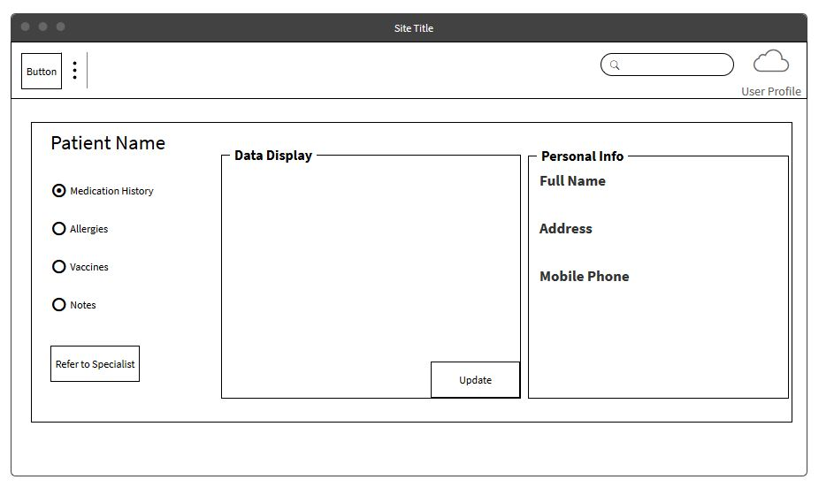
Updated Concepts
VS

Slide 6
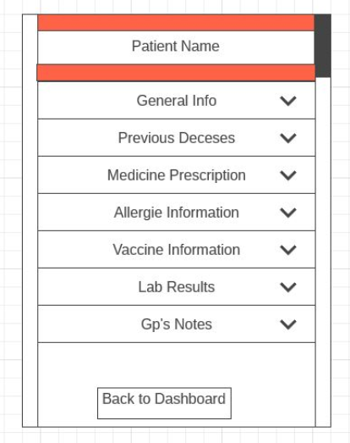
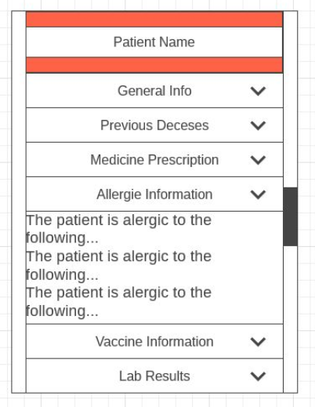
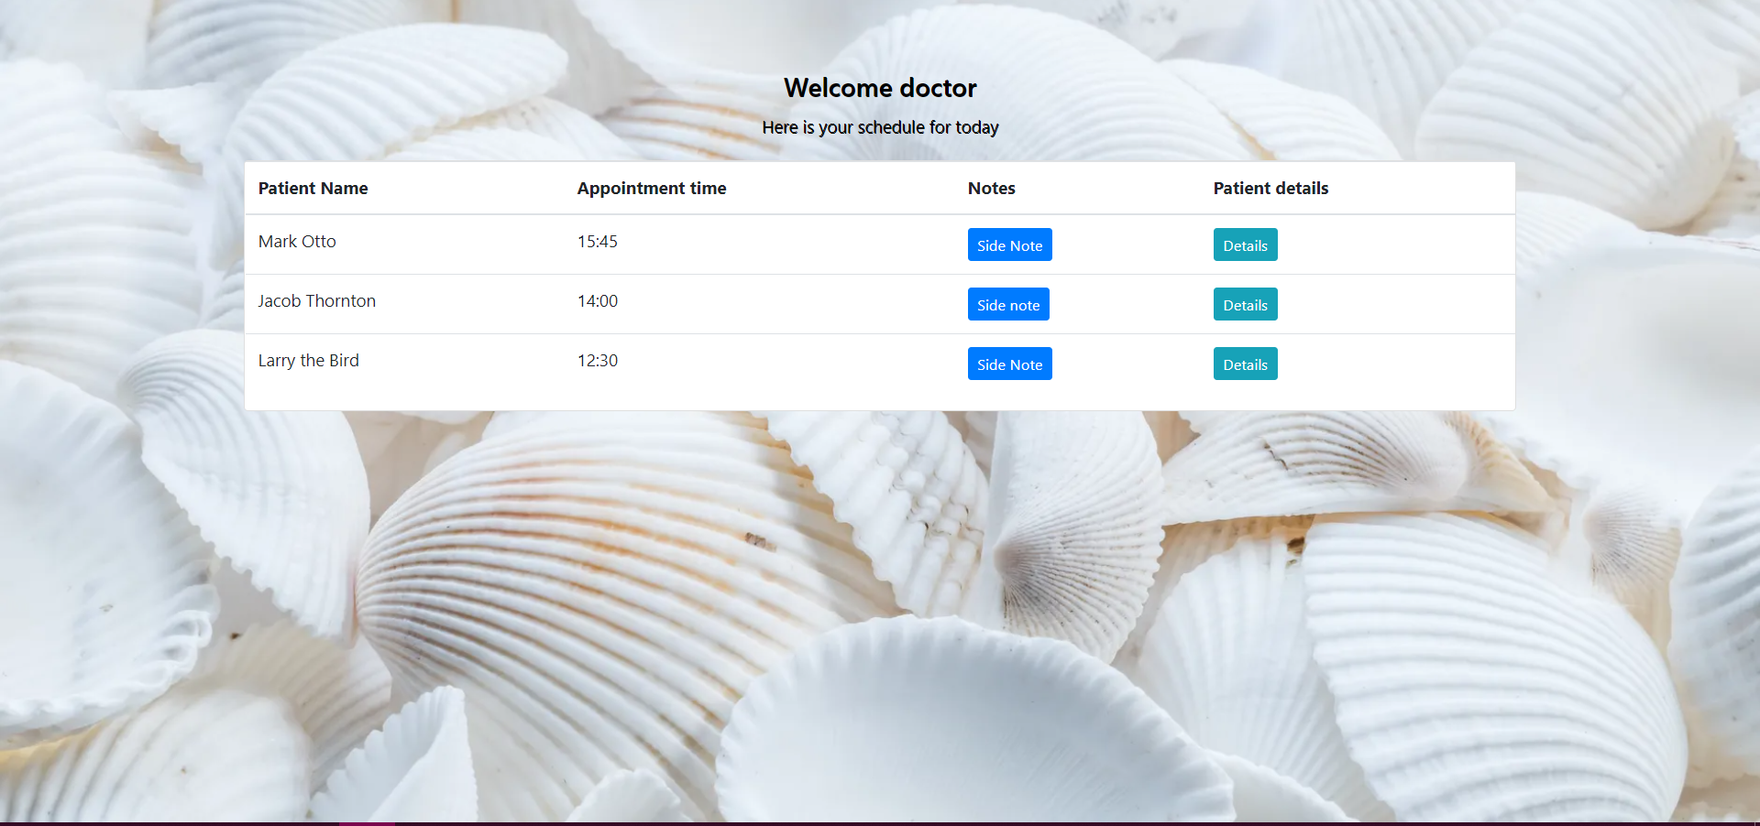
Wireframe reviewFirst Look of The App
Dashboard page
Patient page

Slide 7

Questions

Slide 8
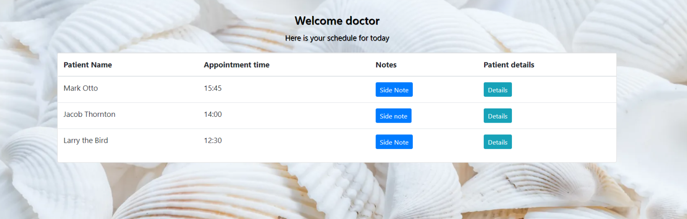
Website demo

Slide 9
{ Discussion time }

